Slide 1

Car Make and Model Prediction Using Machine Learning
Team 06 | Big Data Analytics
Team Members:
Sai Kiran Belana
Ummea Salma
Ariannah Black
Md Ishtyaq Mahmud
Department of Computer Science and Engineering University of Connecticut, Storrs

Slide 2

Outline:
Problem Statement
Dataset
Dataset Preparation
Model and Technique Selection
Initial Model Evaluation
Error Analysis
Methods of Improving the Model
Conclusion and Future Works

Slide 3

Problem Statement
Project Goals:
Significance:
Developing a usable machine learning model to quickly and accurately identify the car’s make and model from an Image.
Enable enhanced traffic safety, aid in recovery of stolen vehicles, and support authorities in enforcing traffic laws.
Improves efficiency and accuracy in vehicle identification across various sectors, including law enforcement and insurance.

Slide 4
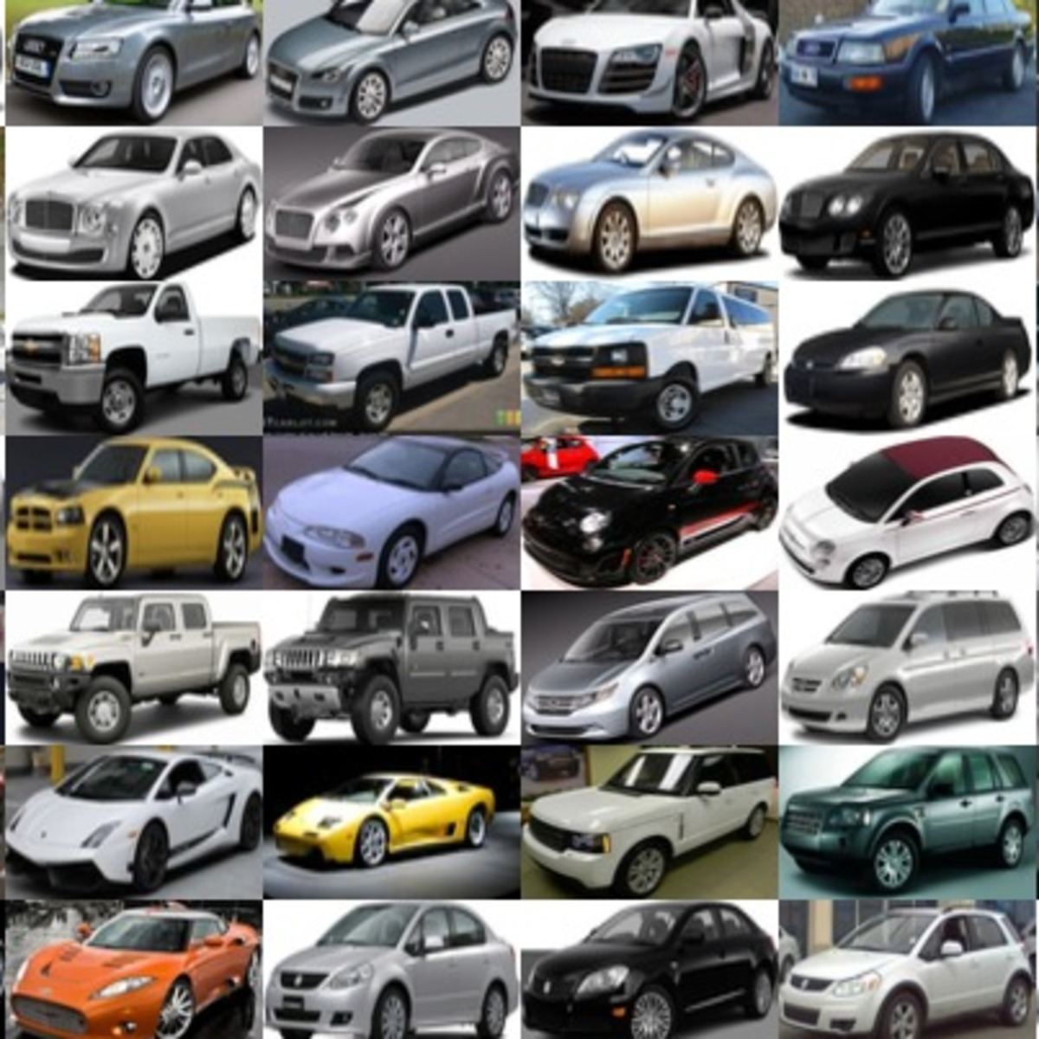
DataSet Overview
Dataset:
Stanford Car Dataset
Description:
Contains 16,185 images.
Represents 196 different vehicle classes.
Used for car make and model identification.
Annotations:
Includes metadata:
Bounding box coordinates (x1, y1, x2, y2).
Class names and numbers for each image.
Annotations aid in precise model training.

Slide 5
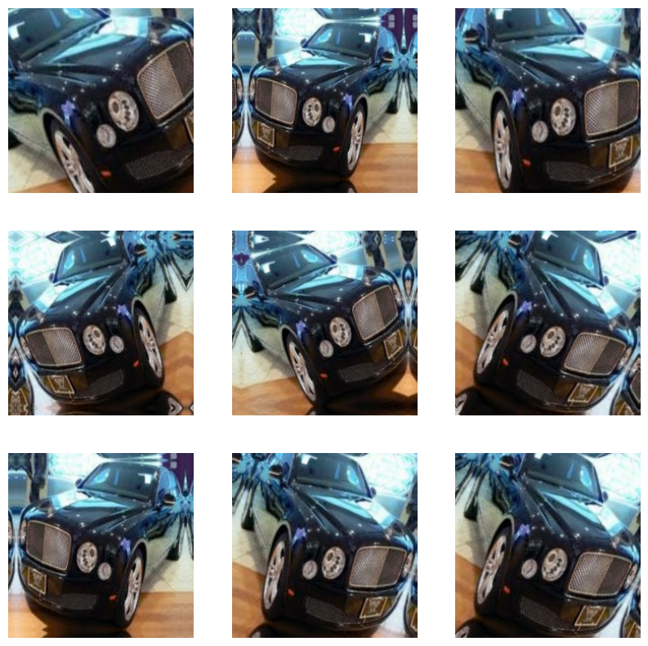
Dataset Preparation
1. Dividing the Dataset
Training and testing set with the ratio of 80/20
Splits the resulting training set into training and validation with ratio of 75/25
No missing or incomplete data in the dataset
2. Cropping Images:
Images were cropped according to their bounding boxes to focus on the vehicles and reduce noise.
3. Resizing Images:
Images resized to 299x299 pixels to maintain consistency and detail necessary for accurate classification.
4. Data Augmentation:
Applied techniques like random erasing and image transformations to increase dataset diversity and reduce overfitting.
Fig: A number of images produced by a single instance after data augmentation, random eraser not visualized.

Slide 6
Using Transfer Learning Model

Slide 7

Model and Technique Selection:
Initial Approach: Started with basic CNN models; explored feature extraction and augmentation techniques.
VGG16 Model: Started with VGG16 since the dataset is smaller.
Xception Model: Considering the Xception model, after facing challenges with other models like VGG16.
Chosen for its efficiency and effectiveness, utilizing depthwise separable convolutions for enhanced learning.
Fine-tuning Strategy: To prevent overfitting and ensure stable performance and increase accurate predictions, the models included additional layers for regularization.

Slide 8
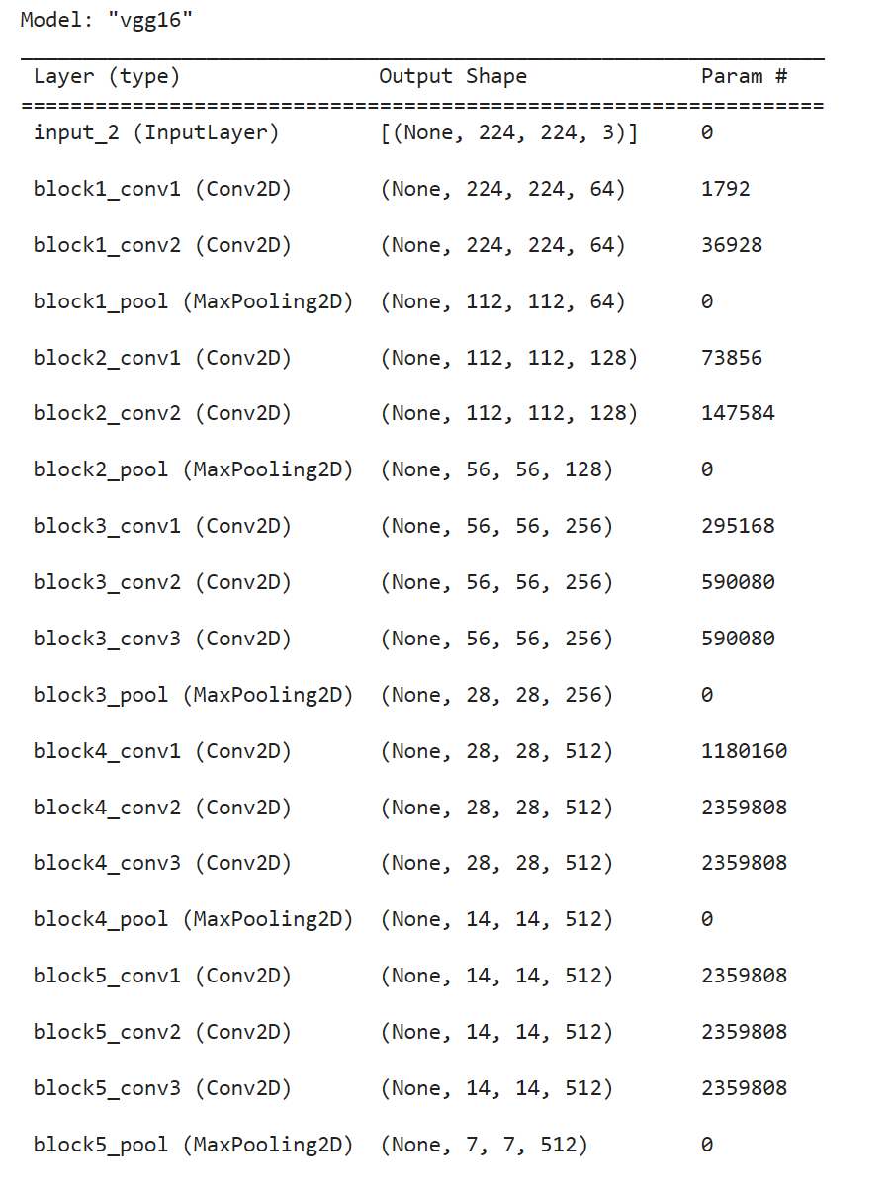
Initial Model Evaluation:
Evaluation of Previous Model: VGG16
Utilized VGG16 model for feature extraction, excluding top layers, and designed a new model for fast feature extraction without data augmentation.
Model Compilation:
Loss function: Sparse categorical cross-entropy
Optimizer: RMSprop
Metrics: Accuracy for training
Training Results:
Higher training and validation accuracies observed.
However, both training and validation losses are significantly higher.
VGG16 model couldn't predict images properly.
Fine tuning the model by freezing last four layers increases the accuracy but we got higher losses leading to an unusable model.

Slide 9
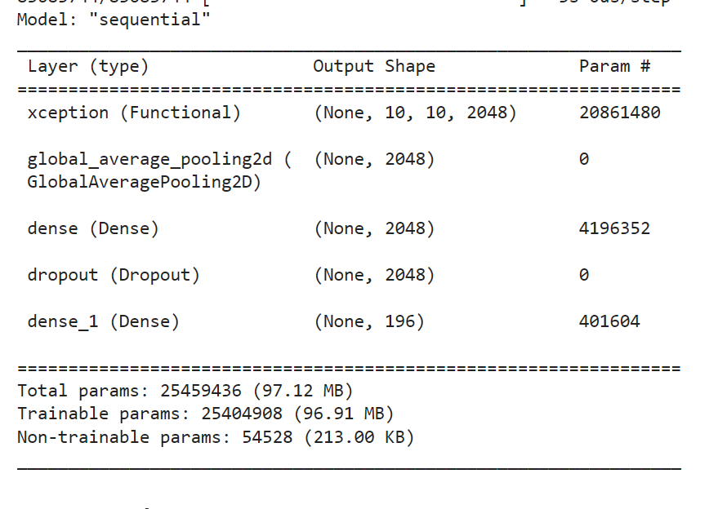
Xception Model Evaluation:
Chosen for its efficiency and effectiveness, utilizing depthwise separable convolutions for enhanced learning.
Techniques applied for Data Augmentation:
Image rotations, Width and height shifts
Horizontal flip
Zoom range, Shear range, Brightness ranges
K-Fold Cross-Validation:
Used to assess the performance and generalization ability of the machine learning model.
Split the dataset into K = 2 subsets (or folds).
Trained the model K times, each time using a different subset as the validation set and the remaining subsets for training.
Training:
Achieved high validation accuracy of 99.50% and low validation loss of 0.0150
Testing:
Achieved approximately 94.6% test accuracy.

Slide 10
Model Evaluation:
VGG16 with Fast Feature Extraction
Achieved a high training accuracy of 97.02%.
However, validation accuracy was significantly lower at 66.02%.
Higher validation loss compared to training loss indicated overfitting.
2. VGG16 with Feature Extraction and Data Augmentation
Implemented feature extraction with data augmentations to address overfitting.
Training accuracy improved to 93.71% and validation accuracy to 81.74%.
However, overfitting persisted, leading to higher losses for validation data (more than 100%) and incorrect class predictions.
3. Xception with K-Fold Cross-Validation
Utilized Xception architecture with K-Fold Cross-Validation.
Achieved significantly higher validation accuracy compared to VGG16.
Demonstrated the best performance among the models.
Test Performance:
Predicted classes of test images with an average accuracy of approximately 94.60%.
Out of 3027 testing images, 2853 were correctly predicted (unseen data).

Slide 11
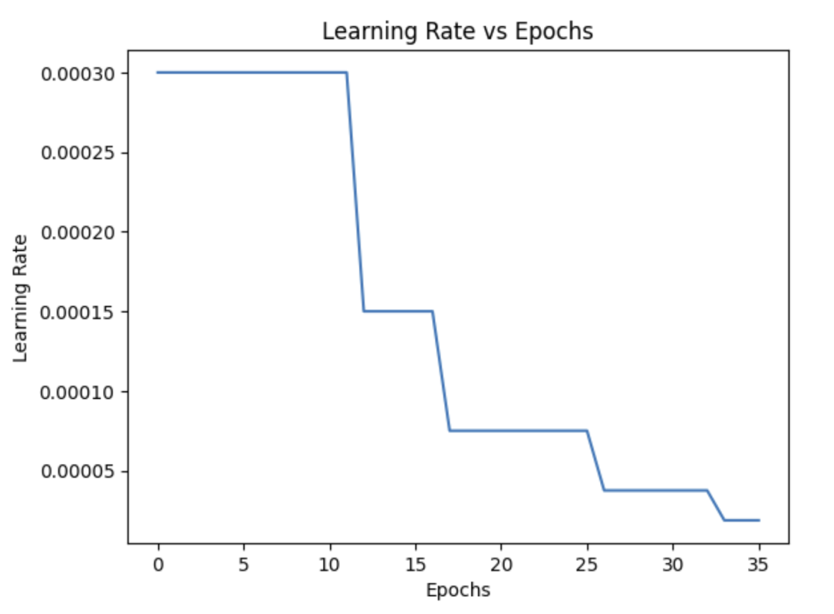
Methods of Improving the Model: Xception and VGG16
For reducing overfitting, Early Stopping was introduced to halt training once model performance stops improving on the validation dataset.
Modified the Number of Epochs to adjust overfitting and underfitting.
Added Custom Layers such as GlobalAveragePooling, Dropouts, and extra dense layers converging to # of classes using Softmax.
Added Optimizers such as Nadam optimization function helped to reduce the overall loss and improve the accuracy throughout training and validation.
Adjusted Learning Rate to decrease epoch by epoch.

Slide 12
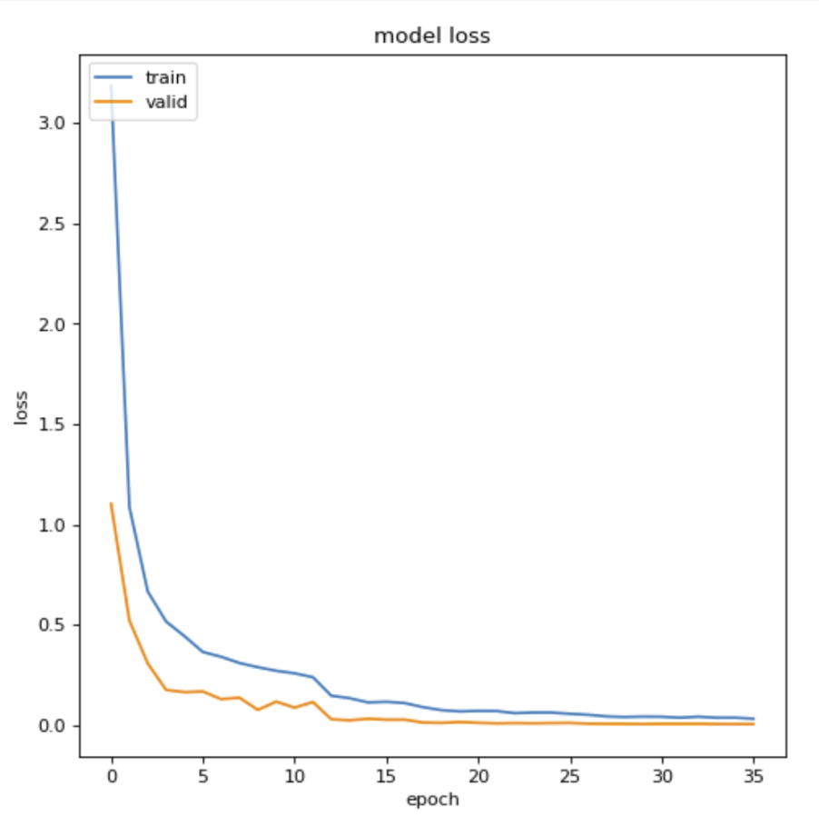
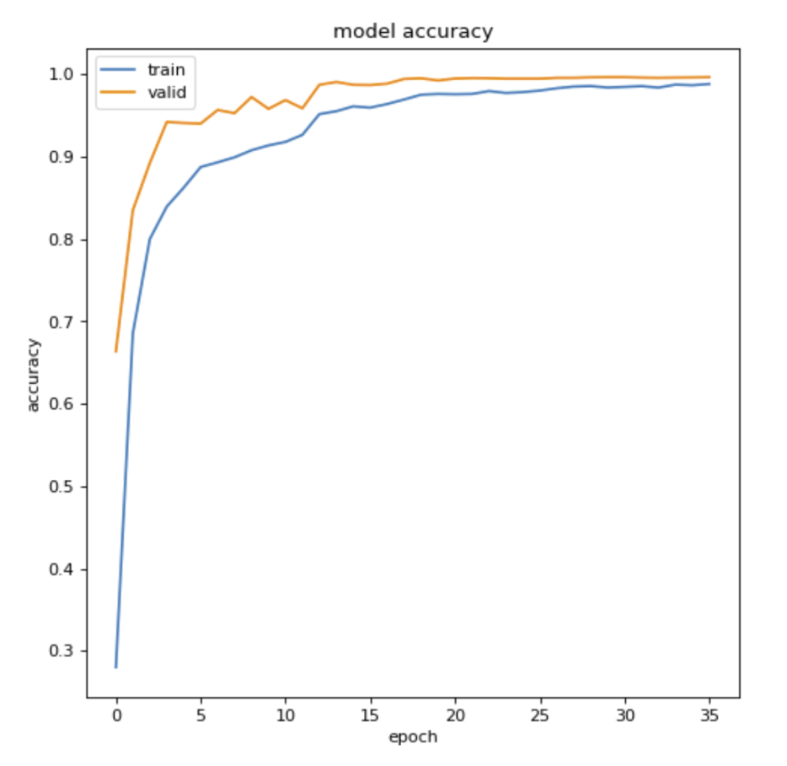
Model Evaluation - Xception
Model accuracy indicates the percentage of correct predictions made by the model, while loss represents how well the model is performing based on the difference between predicted and actual values.
Finally got 94.60% test accuracy using Xception.
Training loss: 3.16%
Training Accuracy: 98.80%

Slide 13
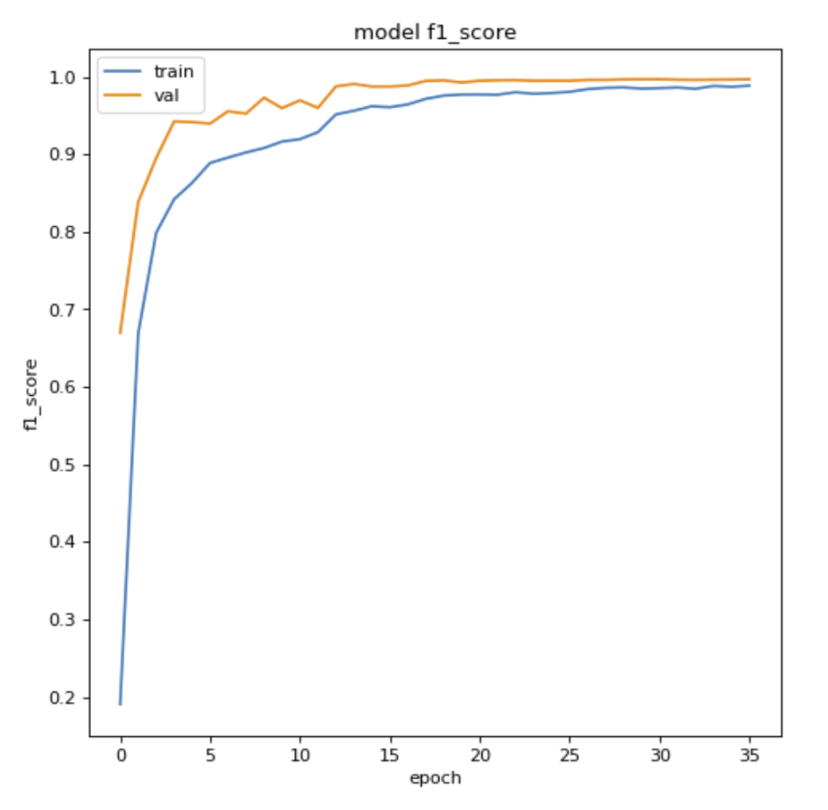
Model Evaluation - Xception
The F1 score, a metric that combines precision and recall into a single value, increased substantially after around 10 or 15 epochs. A high F1 score indicates a balance between precision and recall, showcasing the model's ability to make accurate and comprehensive predictions.
f1_m: 98.83
Validation Loss: 0.58%
Validation Accuracy: 99.69%

Slide 14
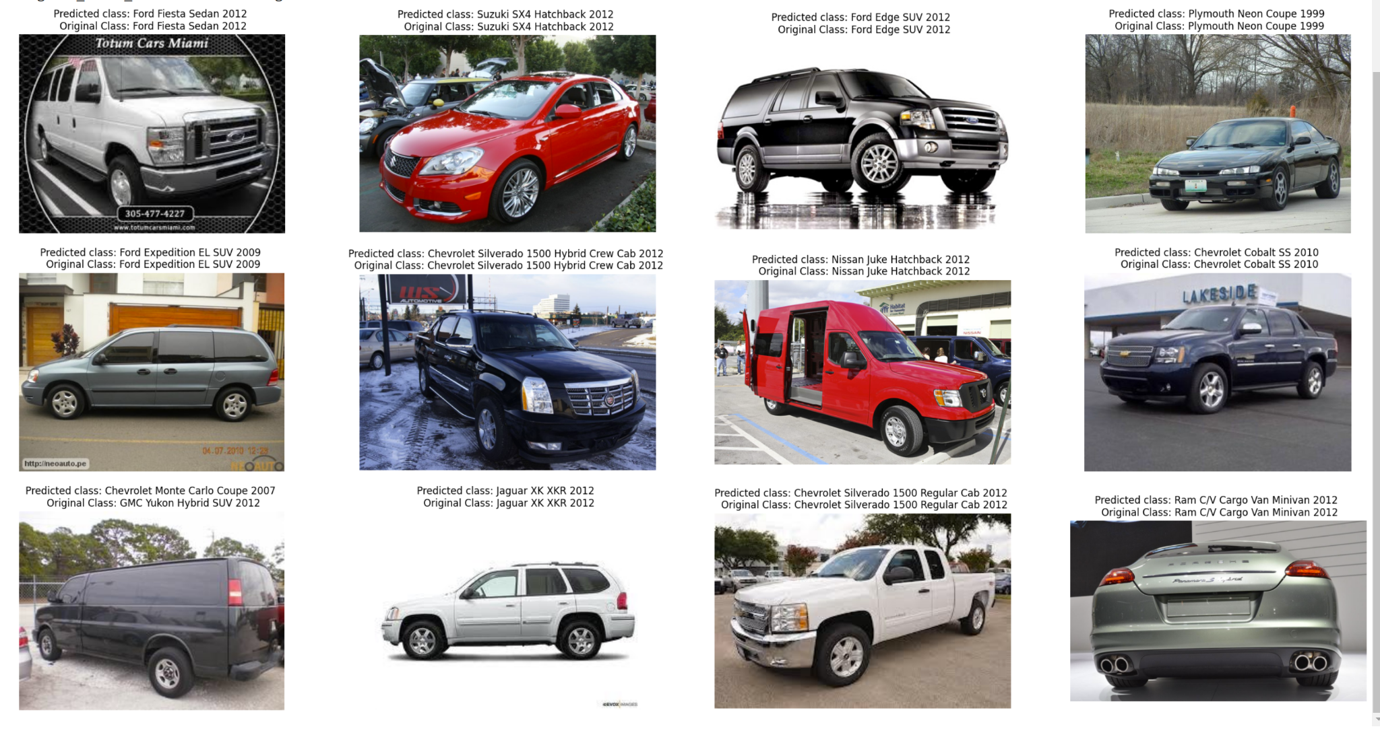
Results on Test DataSet
2853 images are correct out of 3027 testing images - unseen

Slide 15
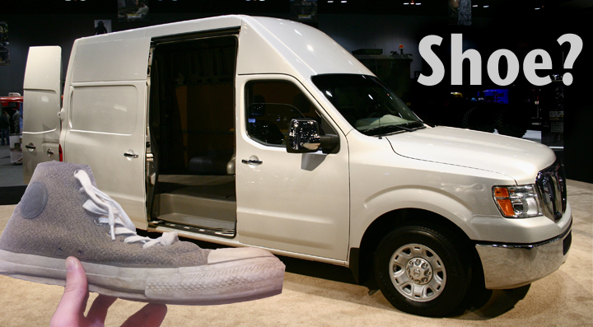
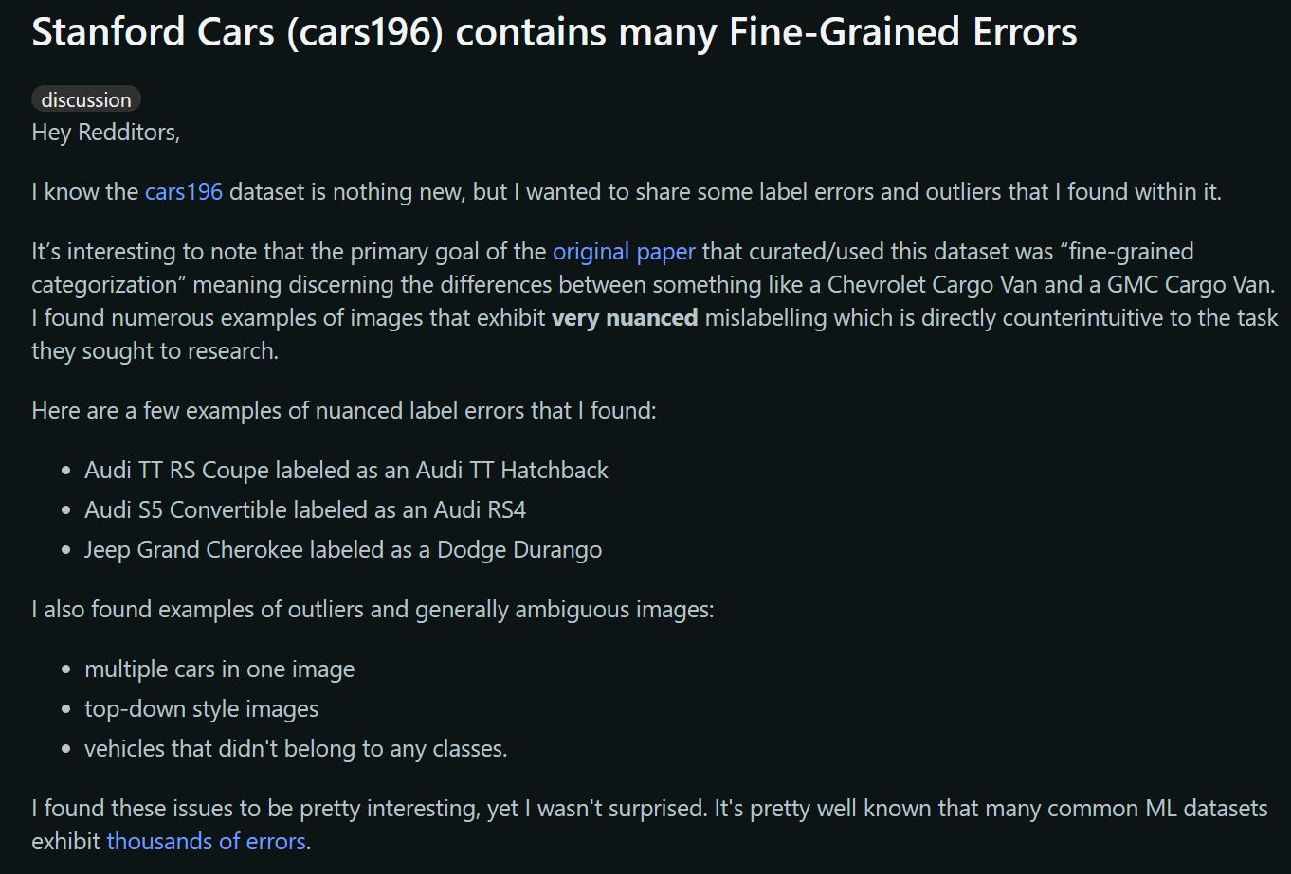
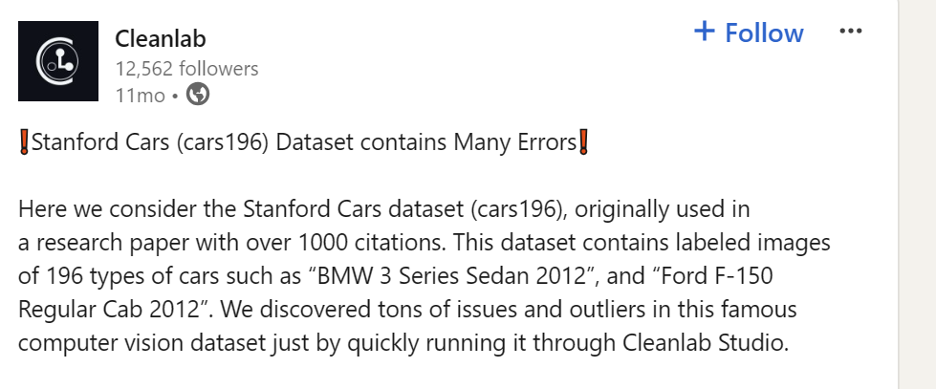
What went wrong ?
Upon Manual Inspection, some of the images are having wrong class names and some are useless.
Proof from Internet:

Slide 16
Conclusion and Future Work
Issues with Stanford Cars:
Some images with classes mislabeled, belonging to classes other than their assigned ones.
Ambiguous images, which include multiple cars within a single image.
Limitations:
Nuanced, but significant issues with the dataset.
A lack of time for model development, training, and research.
A lack of computing resources and funding.
Future Work and Project Extensions:
Re-clean the data.
Add more images to each class.
Need to do a detailed analysis on VGG16 to improve its accuracy and reduce the loss occurring due to overfitting.
Create a usable API for predicting the results on new unseen data using the Xception Model.
Run with real-time video feed and predict the results on the go.

Slide 17
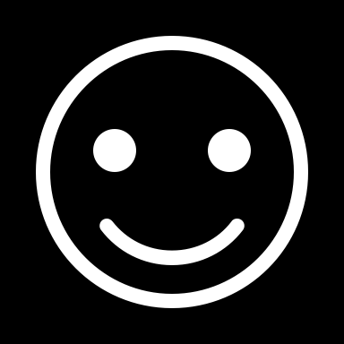
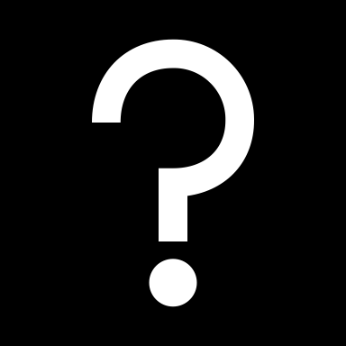
THANKS!!
QUESTIONS?

